Slide 1
Functional Automation,
Performance Test and TDM Services

Slide 2
Functional Automation
To engage the functional automation team follow the steps below:
♦ The first thing is to submit an email request to “DL Apollo Automation Team”. A functional automation test questionnaire document will be provided to the requester.
♦ The Functional Automation Questionnaire will be used to identify what test cases you would like automated, which environments to automate in and any other pertinent information around test automation. Once filled out, a meeting is setup to review the questionnaire to get any questions answered in that meeting etc.
Questionnaire - http://coin/Sites/corpit/IT_Governance/TMO/Functional%20Automation%20Questionnaire/Forms/AllItems.aspx
Below chart is our Functional Automation process.
Functionality
The TMO Automation Team provides functional automation capability for web based applications, including GUI, webservices and Database validations. Automation can be done for Smoke and Regression tests.
Intake
Design
Develop
Execution
Report
a. Receive Request
b. Fill Out Questionnaire
c. Have Meeting to Review Questionnaire
d. Ensure App is Stable for Automation
e. Test Case Adequate
f. App is Automatable with Technology
g. Funding Available
a. Review Test Cases
b. Identify Scope of Effort
c. Provide estimate
d. Get Funding Approval and Build Schedule
e. Design Reusable Components
f. Setup Test Data
g. Assign Lead & Developers
h. Create GitHub Repository for App
a. Build Objects
b. Build Components
c. Build Test Cases
d. Unit Test
e. Configure ALM Parameters
f. Update Development Status
a. Identify Workstations
b. Build Jenkins Jobs
c. Configure Smoke
d. Configure Regression
e. Coordinate ARA Team
f. Update Development Status
g. Build Execution Document
h. Execute Tests via Jenkins
a. Ensure Execution Results in ALM
b. Communicate Status to External Project Team
c. Communicate Status to Internal Automation Team
d. Build and Execute Status Reports
e. Build and Distribute Monthly Metrics
f. Create Automation Metrics

Slide 3
Functional Automation – Process & Benefits
Analyze and verify the application is stable for automation
Kickoff meeting with customer/project teams to understand their needs/requests for automation
Discuss about application under test, web based GUI, web services, database?
Where the test cases are located, is it in ALM?
Number of the test cases needs to be automated
Analyze the test cases, feasibility study
Prepare the initial estimate based on number of resources, number of days to automate, number of test cases to automate, number of environments the test cases to be automated
Review estimate with project teams and get approval
Automation Benefits
Reliable
Reusable
Fast
Cost Reduction

Slide 4
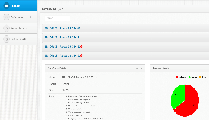









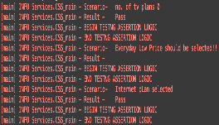
Functional Automation
Test Framework & Scripts
Continuous Integration
Test Reporting
Release Certifications
Automation Framework and Script
Creation
Source
Control
Test
Scheduling
Executive
Reporting
Detailed
Reporting
Code Execution
Common
Logging
Volume
Common
Logging
Executive
Reporting
Framework Creation
Test Script Creation
Source
Control
Test
Scheduling
Automated Test Execution
Common
Logging
Detailed
Reporting
Executive
Reporting
Create New Framework & Evaluate existing automation harness
Create New Test Scripts with Selenium Web Driver and Java (Open Source)
Load sources into source control for use in continuous build
Configure Test Jobs for ingestion by a Continuous Integration solution
Define and implement auto-build process that incorporates dependencies
Define and implement logging standards
Continuous Integration-based reporting modules and visualizations
Define common classes for integration with HP ALM and Jenkins Reporting

Slide 5
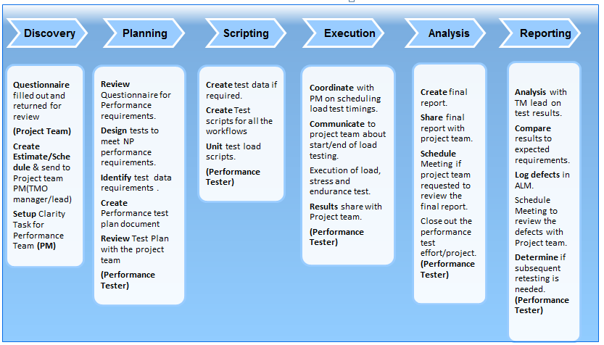
Performance Team
To engage the performance team follow the steps below:
♦ The first thing is to submit a simple request to our SharePoint site.
Request SharePoint - http://coin/Sites/corpit/IT_Governance/TMO/Lists/PErformance%20Testing%20Requests/AllItems.aspx.
♦ The Questionnaire is primarily our performance testing requirements that we need from beginning to end. If any team needs help with the
questionnaire , a meeting is setup to review the questionnaire to get any questions answered in that meeting etc.
Questionnaire - http://coin/Sites/corpit/IT_Governance/TMO/QUTemp/Charter%20TMO%20Performance%20Test%20Process%20ver05.doc
Below chart is our Performance Test process.

Slide 6
Performance Team
Load Testing Types
Load Testing
♦ Application is subjected to a simulated real time user load or the load expected on the application when it goes live to ensures
that the application will be stable and any performance issues can be addressed in pre-production phase.
Performance Testing
♦ Performance testing is the process of measuring responsiveness of system as you vary workload to identify trending with smoke with less number of users.
Endurance Testing
♦ The user load sustained over longer period of time with normal ramp up and ramp down time. This uncovers the performance bottlenecks like memory leaks, which becomes visible when the system is subjected to normal load for a prolonged time.
Stress Testing
♦ During Stress testing application is subjected to a gradually increasing load till the application reaches saturation point (break point).
Tools
Tools used to create all scripts and simulate load on the servers
Jmeter
Tools Monitoring Network resources
HP OpenView
CPM

Slide 7
Test Data Management - TDM
The TDM Team primarily assists the QA Testing Teams within the Test Management Office; however, we are also available to assist other business partners in Development, UAT and Production, as well as our Automation and Performance Testing Teams. Our support primarily includes, but isn’t limited to, the following:
♦ Lab Work
• Ensure that all devices in the Test Lab are online, functioning and performing as they should for the testers and other business partners when:
Devices aren’t responding to provisioning
Devices aren’t working when provisioned
Devices aren’t appearing in BACC (online provisioning inquiry tool)
• Install new devices for testing efforts when requested
• Remove devices when:
They are no longer needed
When transferred to another lab for other use; or
When defective
• Perform device cleanup for future use with other testing efforts. Cleanup is performed in:
BACC
UIM (Repository for CSG active services and devices)
♦ Create locations (test addresses) – residential and commercial in the following environments:
• QAKA (Legacy Charter CSG)
• QAHA (Legacy Time Warner Cable CSG)
• Production (Legacy Charter CSG – Live)
♦ Create test accounts for all lines of business (HSD, Telephony and Video) for the test residential and commercial test addresses in the following environments:
• QAKA (Legacy Charter CSG)
• QAHA (Legacy Time Warner Cable CSG)
• Production (Legacy Charter CSG – Live)
The TDM Team primarily assists the QA Testing Teams within the Test Management Office; however, we are also available to assist other business partners in Development, UAT and Production, as well as our Automation and Performance Testing Teams. Our support primarily includes, but isn’t limited to, the following:
♦ Lab Work
• Ensure that all devices in the Test Lab are online, functioning and performing as they should for the testers and other business partners when:
Devices aren’t responding to provisioning
Devices aren’t working when provisioned
Devices aren’t appearing in BACC (online provisioning inquiry tool)
• Install new devices for testing efforts when requested
• Remove devices when:
They are no longer needed
When transferred to another lab for other use; or
When defective
• Perform device cleanup for future use with other testing efforts. Cleanup is performed in:
BACC
UIM (Repository for CSG active services and devices)
♦ Create locations (test addresses) – residential and commercial in the following environments:
• QAKA (Legacy Charter CSG)
• QAHA (Legacy Time Warner Cable CSG)
• Production (Legacy Charter CSG – Live)
♦ Create test accounts for all lines of business (HSD, Telephony and Video) for the test residential and commercial test addresses in the following environments:
• QAKA (Legacy Charter CSG)
• QAHA (Legacy Time Warner Cable CSG)
• Production (Legacy Charter CSG – Live)
♦ Create fake devices when a physical device isn’t needed, and only to test device provisioning, in the following systems:
• CSG
• UIM
♦ Provision and maintain real cable modems (HSD-only) and MTA’s (HSD and Telephony) for all testing efforts and TMO teams; provisioning and testing maintenance support for real video devices will be available in the future.

Slide 8
Test Data Management - TDM
♦Create fake devices when a physical device isn’t needed, and only to test device provisioning, in the following systems:
• CSG
• UIM
♦ Provision and maintain real cable modems (HSD-only) and MTA’s (HSD and Telephony) for all testing efforts and TMO teams; provisioning and testing maintenance support for real video devices will be available in the future.
♦ Split Rate Centers from one test environment to another, to allow for additional testing scenarios, with varying
parameters; e.g., current rate center is being used for QA1 test environment, but the same rate center is also needed for
testing in the QA3, UAT or SIT environment. This helps ensure that identical services on a similar account in a different
test environment will display the same behavior in another environment for each testing teams’ needs (SIT Team, QA Team, UAT Team).
♦ Perform automated Telephone Number cleanup for the Automation and QA Testing Teams.
• XML Cleanup for XML Automation Testing, performed by the QA and Automation Teams
• Manual Cleanup for the QA Manual Testers
♦ Monitor all automated telephone number cleanup tasks to help ensure there are no issues in UFT (telephone number cleanup automation tool). This information is relayed to Saravanan Vivekananthan, who then addresses and resolves all technical issues in regards to the automated telephone number cleanup process.
♦ Reserve telephone numbers for the Manual Testing and Automation Testing Teams for both manual and XML testing, when requested.
♦ Create billing test data in ICOMS for Legacy Time Warner testing efforts.
♦ Gather and decipher all TDM, Automation and Performance Teams’ efforts into a comprehensive report, which is then sent to the IT Director of the BA/Testing/Release Department on a weekly basis.
All requests for assistance from the TDM Team are made here.
The TDM Request guiding instructions can be found here
The TDM SLA (Service Level Agreement) can be found here.
The TDM Request Intake and Fulfillment Process Matrix can be found here.
Any and all questions for the TDM Team can be sent to the TDM Team’s Distribution List.

